Slide 1
PRINCIPLES OF DATA COMMUNICATION PROJECT
TOPIC:IMAGE COMPRESSION USING MATLAB SOFTWATE AND HUFFMAN CODING
PROJECT MADE UNDER THE GUIDANCE OF:
Prof. nandhini
GROUP MEMBERS:
NAME | ID NUMBER
PRAKASH NADGERI | 181090033
ABHISHEK . R . NAIR | 181090034
PARTH . J . NAKAR | 181090035
NIKHIL JAIN | 181090036

Slide 2
Images and Image Processing
Human beings are predominantly visual creatures: we rely heavily on our vision to make sense of the world around us. We not only look at things to identify and classify them, but we can scan for differences, and obtain an overall rough feeling for a scene with a quick glance.
What is image processing?
Image processing involves changing the nature of an image in order to either:-
1. Improve its pictorial information for human interpretation,
2. Render it more suitable for autonomous machine perception.

Slide 3
Software Used in the project
MATLAB
Matlab is a data analysis and visualization tool which has been designed with powerful support for matrices and matrix operations. As well as this, Matlab has excellent graphics capabilities, and its own powerful programming language.
One of the reasons that Matlab has become suchan important tool is through the use of sets of Matlab programs designed to support a particular task. These sets of programs are called toolboxes, and the particular toolbox of interest to us is the image processing toolbox.

Slide 4
Digital Images : Introduction
A digital image differs from a photo in that the x,y and f(x,y) values are all discrete. Usually they take on only integer values and will have x and y values ranging from 1 to 256. and the brightness values also ranging from 0 (black) to 255 (white).
Pixels: A digital image can be considered as a large array of discrete dots, each of which has a brightness associated with it. These dots are called picture elements, or more simply pixels.
The pixels surrounding a given pixel constitute its neighbourhood.
Except in very special circumstances, neighbourhoods have odd numbers of rows and columns; this ensures that the current pixel is in the centre of the neighbourhood.

Slide 5
Image Compression : Introduction
How large is an image?
Image les tend to be large. For example, suppose we consider a 512*512 colour image. The number of bits used in this image (assuming no compression, and neglecting any header information) is:
512*512*3=786432bytes
=786.432kb
Many images are of course such larger than this; satellite images may be of the order of several thousand pixels in each direction.
Assuming a word to contain 10 ASCII characters (on average), and that each character requires 8bits of storage, then 1000 words contain 1000*8*10=80,000bits of information
Thus it’s safe to say: ‘A picture is worth one thousand words.’

Slide 6
Image Compression
1.Need for Compression-
Compression is a technique to reduce the quantity of data without excessively reducing the quality of the multimedia data. The transition and storing of compressed multimedia data is much faster and more efficient than original uncompressed multimedia data.
2.Principle behind Compression-
a. Redundancies reduction aims at removing duplication from the signal source (image/video).
b. Irrelevancy reduction omits parts of the signal that will not be noticed by the signal receiver, namely the Human Visual System.
3.Types of Compression (i) Lossless Compression (ii) Lossy Compression
Lossy Compression: The aim is to obtain the best possible fidelity for a given bit-rate or minimizing the bit-rate to achieve a given fidelity measure. Video and audio compression techniques are most suited to this form of compression. If an image is compressed it clearly needs to uncompressed (decoded) before it can viewed/listened to. Some processing of data may be possible in encoded form however. Lossy compression use source encoding techniques that may involve transform encoding, differential encoding or vector quantization.

Slide 7
Lossless Compression
This refers to the compression keeping all information, so that the image can be decompressed with no loss of information. This is preferred for images of legal or scientific significance, where loss of data even of apparent insignificance, could have considerable consequences. Unfortunately this style tends not to lead to high compression ratios. However, lossless compression is used as part of many standard image formats.
Data is compressed and can be reconstituted (uncompressed) without loss of detail or information. These are referred to as bit-preserving or reversible compression systems also.
Lossless compression frequently involves some form of entropy encoding and are based in information theoretic techniques.
A. Lossless Coding Techniques –
a. Run length encoding
b. Huffman encoding
c. Arithmetic encoding
d. Entropy coding
e. Area coding

Slide 8
Huffman Coding
The idea of Huffman coding is simple. Rather than using a fixed length code (8 bits) to represent the grey values in an image, we use a variable length code, with smaller length codes corresponding to more probable grey values.
Huffman codes are uniquely decodable, in that a string can be decoded in only one way
A small example will make this clear. Suppose we have a 2-bit greyscale image with only four grey levels: 0, 1, 2, 3, with the probabilities 0.2, 0.4, 0.3 and 0.1 respectively. The following table shows fixed length and variable length codes for this image:
The average number of bits per pixel can be easily calculated as the expected value=>(0.2*3)+(0.4*1)+(0.3*2)+(0.1*3)=1.7
Although this average is only slightly smaller than 2, it is smaller by a significant amount.
Grey value | Probability | Fixed code | Variable code
0 | 0.2 | 0 | 000
1 | 0.4 | 01 | 1
2 | 0.3 | 10 | 01
3 | 0.1 | 11 | 001

Slide 9
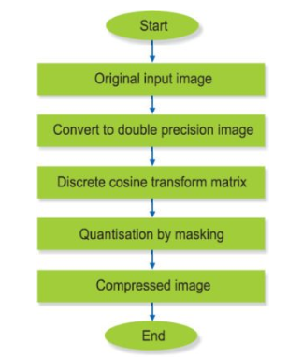
Compression process :Flowchart
Flowchart showing compression process

Slide 10
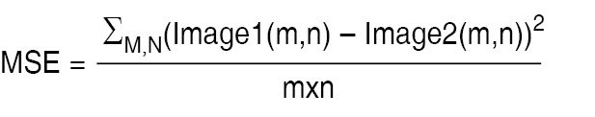
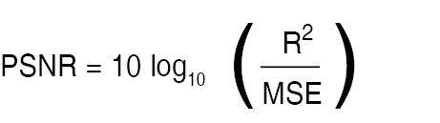
Original Input Image
The image is read through MATLAB to capture its pixels. After obtaining the compressed image, peak-signal-noise ratio (PSNR) and mean-square error (MSE) are calculated using the following relationships:
where m and n are the number of rows and columns. Image1 and Image2 are the original and compressed images, respectively.
After compression, there should not be much change in the quality of the image. MSE indicates an error between the original image and compressed image. It should be as small as possible.
Where R is the maximum fluctuation in the input image data type .PSNR is related to MSE and it gives the amount of noise in a compressed image. PSNR should be as high as possible.

Slide 11
Conversion to Double Precision Image
1.Why is image converted to a double precision image?
MATLAB has two ways of representing RGB and grayscale images:-
1)Images can be represented as double precision numbers (or single precision) in the range 0 to 1.
2)Images can also be represented as integer data classes, especially uint8 (unsigned 8 bit integers), in which case the values are the integers 0, 1, 2, ... up to the maximum representable in the integer class, such as 255. The conversion from integer class to double precision is to switch the numbers to floating point and then divide by the maximum allowed for the class, such as double(ImageData)/255 so 0 still corresponds to 0.0 and 255 corresponds to 1.0
Most of the image file formats store only integers, or "prefer" to store integers. operations on images are easier when the images are represented in floating point. For example if you want to subtract one image from another, if the images are in unsigned integer format, everywhere the second image was greater than the first you would get 0 as the result because unsigned integers cannot represent negative numbers.

Slide 12
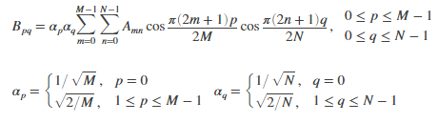
Discrete Cosine Transformation Matrix
The discrete cosine transform (DCT) represents an image as a sum of sinusoids of varying magnitudes and frequencies. The dct2 function computes the two-dimensional discrete cosine transform (DCT) of an image. The DCT has the property that, for a typical image, most of the visually significant information about the image is concentrated in just a few coefficients of the DCT. For this reason, the DCT is often used in image compression applications.
For example, the DCT is at the heart of the international standard lossy image compression algorithm known as JPEG
The two-dimensional DCT of an M-by-N matrix A is defined as follows.

Slide 13
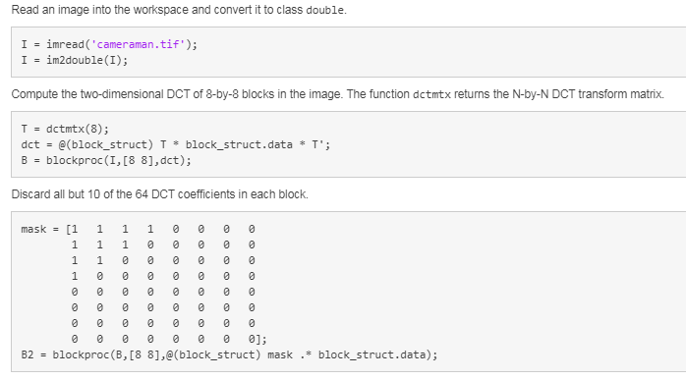
Example of a DCT Conversion
This example shows how to compress an image using the Discrete Cosine Transform (DCT).
The example computes the two-dimensional DCT of 8-by-8 blocks in an input image, discards (sets to zero) all but 10 of the 64 DCT coefficients in each block, and then reconstructs the image using the two-dimensional inverse DCT of each block. The example uses the transform matrix computation method.

Slide 14
Quantization by Masking
3. What is quantization?
Quantization, involved in image processing, is a lossy compression technique achieved by compressing a range of values to a single quantum value. When the number of discrete symbols in a given stream is reduced, the stream becomes more compressible. For example, reducing the number of colours required to represent a digital image makes it possible to reduce its file size.
4. What is masking?
Masking involves setting some of the pixel values in an image to zero, or some other "background" value.
Masking can be done in one of two ways:-
1.Using an image as a mask. A mask image is simply an image where some of the pixel intensity values are zero, and others are non-zero.
Wherever the pixel intensity value is zero in the mask image, then the pixel intensity of the resulting masked image will be set to the background value (normally zero).
2. Using a set of ROIs as the mask. The ROIs for each slice are used to define the mask.

Slide 15
Masking
5. Why we have defined three mask matrix?
Matlab reads image in RGB format. Using array indexing we separated the R,G,B channels of image and then we converted them to double precision images individually.
True colour, or RGB:
Here each pixel has a particular colour; that colour being described by the amount of red, green and blue in it. If each of these components has a range(0-255) this gives a total of 255^3=1,67,77,216 different possible colours in the image. This is enough colours for any image.
Since the total number of bits required for each pixel is 24, such images are also called 24 bit colour images

Slide 16
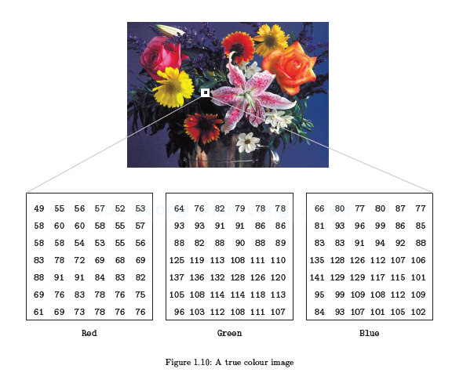
RGB Continued.
An image may be considered as consisting of a stack of three matrices; representing the red, green and blue values for each pixel. This means that for every pixel there correspond three values.

Slide 17
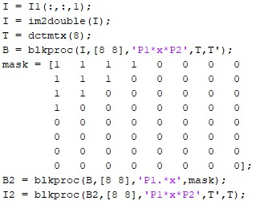
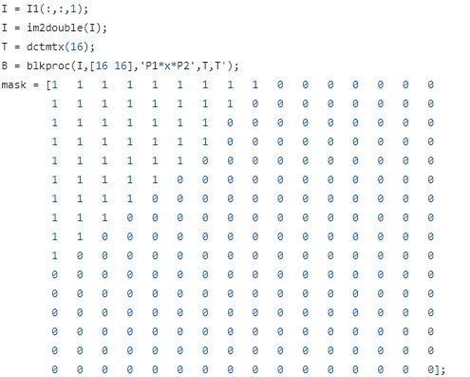
Comparison of two masked Matrices.
What is significance of blkproc()?
First we separated the R,G,B channels and defined discrete cosine transform matrix. blkproc() processes the image I by applying the function to each distinct m-by-n block of I. It is used for implementing distinct block processing for an image and it returns a matrix or vector or scalar.
EARLIER MASKING
NEW MASKING

Slide 18
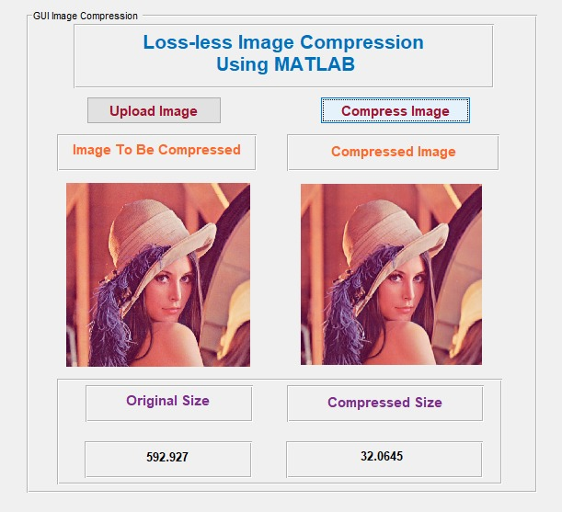
Compressed Image
Here is an example of what the output of the Project, i.e: Lossless Compression of images using MATLAB looks like:-
Notice how with only minor changes visible to our visual perception, we are able to drastically reduce the image size to suit our requirements.

Slide 19
Conclusion and Future Scope
As a future work more focus can be on improvement of compression ratio using the new techniques.
The proposed technique can be experimented on different kinds of data sets like audio, video, text as till now it is restricted to images.
New methods can be combined and proposed that decreases the time complexity incurred in creating dictionary. Further the work can be extended to video compression.
Video data is basically a three dimensional array of colour pixels, that contains spatial and temporal redundancy. Similarities can thus be encoded by registering differences within a frame where data frame is a set of all pixels that correspond to a single time moment.
With the advancements in compression technology, it is now very easy and efficient to compress video files.

Slide 20
Applications of Image Processing
Image processing has an enormous range of applications; almost every area of science and technology can make use of image processing methods. Applications:-
1)Medicine
Inspection and interpretation of images obtained from X-rays, MRI or CAT scans.
2)Agriculture
Satellite/aerial views of land, for example to determine how much land is being used for different purposes, or to investigate the suitability of different regions for different crops
3)Industry
Automatic inspection of items on a production line.
4)Law Enforcement
sharpening or de-blurring of speed-camera images.
Fingerprint Analysis

Slide 21
Bibliography
Lossless Image Compression through Huffman Coding Technique and Its Application in Image Processing using MATLAB by Vikash Kumar, Sanjay Sharma.
An Introduction to Digital Image Processing with Matlab by Alasdair McAndrew.
Image Processing Toolbox™ User’s Guide by The MathWorks, Inc
Digital Image Compression Techniques by Majid Rabbani and Paul W Johnes , SPIE Press

